Slide 1
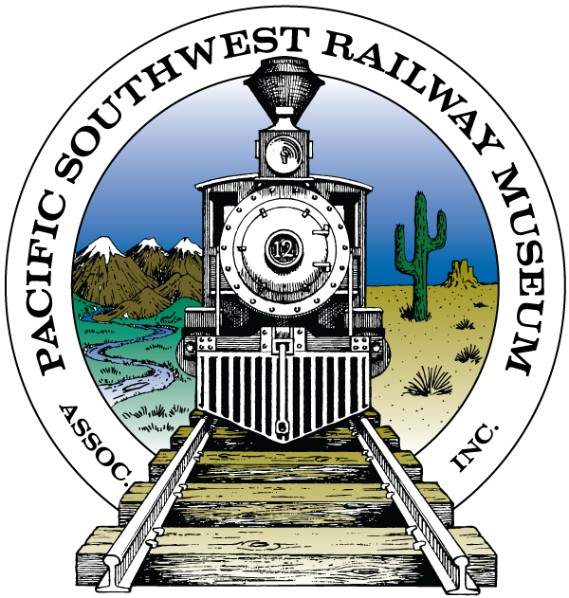
Community Enhancement Funding Request
Pacific Southwest Railway Museum Association, Inc.
Fiscal Year 2018/19

Slide 2
Campo Railroad Park and Museum in Campo, CA
As one of the busiest museums in East County, PSRMA’s Campo Railroad Park and Museum continues to attract 10,000-15,000 visitors annually As we continue to expand and improve our exhibits and interpretive programs, we hope to attract more visitors
However, with a little assistance, PSRMA’s outreach can expand beyond its current visitor base to attract thousands more visitors to San Diego County each year

Slide 3
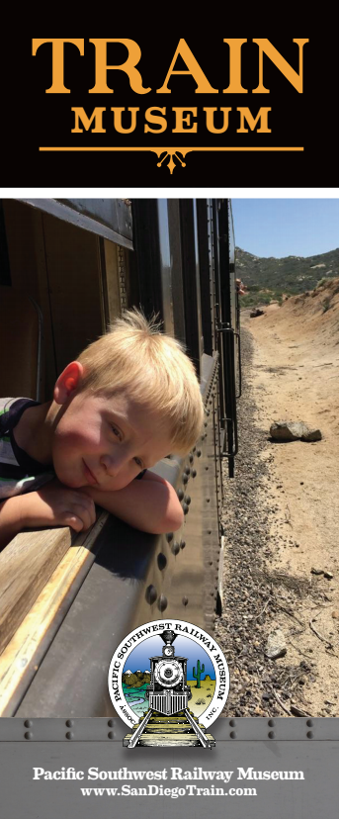
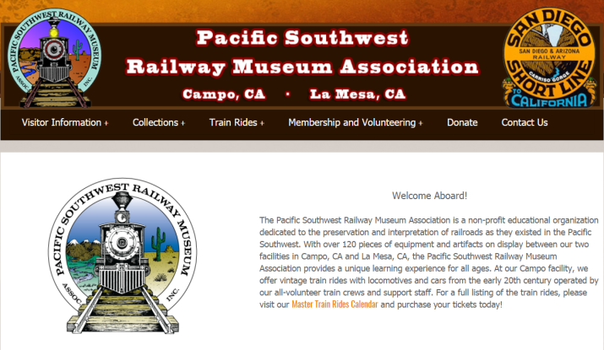
Current Marketing and Advertising Efforts
Presently, PSRMA volunteers engage in limited marketing efforts:
Digital Marketing on PSRM.Org website
Digital Marketing through PSRMA Facebook page
Print ads in San Diego Family Magazine and others
PSRMA Newsletters, brochures, and other fliers
PSRM.Org Website
PSRMA Print Brochure

Slide 4
Advertising Potential and Impact on PSRMA
With access to granted funds, we hope to pursue a contract with a professional advertising agency to more efficiently spread the word about PSRMA It is our hope to reach out to more visitors and increase access by San Diego County residents, among others, to our educational programs, interpretive displays, and other ongoing community outreach. Additionally, more visitors leads to more revenue which can be used to restore additional locomotives and train cars for display, increase staff on hand to open the Museums in Campo and La Mesa several days per week, and other benefits.

